Slide 1
GAVS’ Solution to < >
Notes:
ADD QUALITY STATEMENT

Slide 2
Background
About client
About the Services being offered
Customer’s business background and requirements

Slide 3
GAVS’ Approach
Notes:
ADD QUALITY STATEMENT

Slide 4

Approach to Transition
Global Delivery Setup
Transition application
Manage application
Integrated processes
Infrastructure and connectivity
Proven transition approaches
Process, tools and metrics for service delivery
Risk mitigated global delivery
Metrics driven application management methodology
Enablers
<Customer> – GAVS Service Delivery Excellence
Cost efficiencies through global delivery
Resource flexibility
Quick savings from accelerated knowledge transfer & high offshore ratio
Repeatable process / tool based
Robust managed services model
SLA based approach
Continuous process improvement
Value

Slide 5


Knowledge Transition Methodology
Project
scope &
baselines
Knowledge Transition
Steady State
Planning
Knowledge
Acquisition
Guided
Support
Lead Support
Planning Workshop
KT Score Card
Knowledge Portal
KT
Quiz
KT Process Handbook
KT Sign-off
Reports
Monthly Metrics
Create a detailed KT plan
Study existing documents and workflows
Infrastructure planning (voice, data network and security)
  Business process understanding - technical, functional and people
Understand configurations, interfaces and customizations
Reverse transition to validate understanding
DHL SME own resolution
GAVS resources learn through observation and tries out low priority tickets
Update KM portal
GAVS take up responsibility for support requests with DHL SME oversight
Offshore support assessment
Finalize steady State plan – communication, infrastructure, reporting
Execution of all activities as per scope
Collection, analysis & reporting of metrics
SLA compliance
Ongoing productivity improvement
EMO
0% 100%

Slide 6
Knowledge Transition – Planning Phase
Objective: Validate application inventory and scope. Baseline detailed transition plan for Knowledge Transition (KT)
ROLE
ROLE
Key deliverables
Example:
Detailed scope document and transition plan
Baselined application inventory
Detailed project plan
Infrastructure & change management plan
Staffing plan
KT scorecard
<Activities>
Key activities:
Sign off/Exit criteria
Detailed project plan approved by client
Approved KT scorecard
6

Slide 7
Knowledge Transition – Knowledge Acquisition
Objective: In-depth understanding of DHL application and related interfaces
ROLE
Transition team
Key deliverables
X
Y
z
Activities
Key activities
Onsite
X
Y
Z
Offshore
X
Y
z
Sign off/Exit criteria
Processes and application has been understood and documented as per the agreed KT benchmarks
7

Slide 8
Knowledge Transition – Guided Support Phase
Objective: Closely follow and learn from DHL staff and take-up incidents with support from DHLstaff
Role
SMEs
Transition team
Key deliverables
Incidents resolved by GAVS team
Reverse KT presentations
Client involvement
<Sample>
Workshops
Share details on calls resolved during the KT phase
Work allocation
Assign non critical support calls to GAVS team
Reviews
Review and approve support calls resolved by GAVS team and development/testing work by GAVS team
Review support process, call resolution and documentation
Key activities
Onsite
X
Y
Z
Offshore
X
Y
Z
Sign off/Exit criteria
client team to sign off KT process documents
Client team to sign-off on <mention areas > that can be transitioned to GAVS team
8

Slide 9
Knowledge Transition – Lead Phase
Objective: GAVS takes primary ownership in all activities
Leads
SMEs
GAVS team
Key deliverables
Incidents resolved by GAVS team
Status and performance reports as agreed
Baselined SLAs and metrics to be adhered to in steady state
Updated support processes manual & SLA handbook
Client involvement
Key activities
Onsite
X
Y
Z
Offshore
X
Y
Z
Sign off/Exit criteria
All support calls resolved by GAVS team independently
Baselined SLAs established for steady state phase
9

Slide 10
Team Composition
A
a3
a2
a1
Multi-functional team consisting of domain and technology people

Slide 11
Business Analyst Involvement during Transition
Draw the diagram to represent the involvement of BA.
Business Analyst involvement will ensure appreciation of <Client>business process and effective knowledge transition to the support team

Slide 12
Indicative effort from <client> during Transition
Draw the diagram to represent.
12

Slide 13
Support needed from <Client> during Transition
13

Slide 14
KT Effectiveness via Metrics
Mention the details
KT metrics – overall KT progress, transition scorecard
Guided – tickets handled by GAVS involvement /total no. of tickets received
Lead – tickets handled independently by GAVS /total number of tickets
Steady state - lead – tickets resolved within SLAs /total number of tickets
Effort variation – budgeted vs. actual hours
Metrics for Transition

Slide 15
Steady State
Notes:
ADD QUALITY STATEMENT

Slide 16
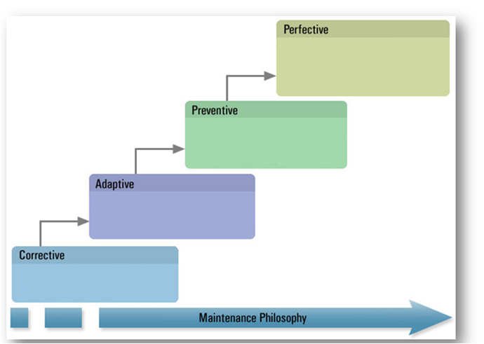
Approach to Steady State
<Sample provided>
Service Level adherence and continuous improvements
Focus on SLAs, Key Performance Indicators
Steady state governance
Use in-house tools for SLA monitoring and reporting
Process robustness for uninterrupted service delivery

Slide 17


Steady State – Ongoing Support
Pick an assigned or open high priority ticket
Sample provided
Look-up ticket management system & KM portal
Troubleshoot and Resolve tickets
Update ticket management system & KM portal
Hand off: Email /
Conference Calls
<Support activities>
<Support activities>

Slide 18
Infrastructure and Connectivity
Represent diagrammatically>

Slide 19
Typical Ticket Process

Slide 20
Metrics during Steady State
Give the details of the dashboard, analysis sample,charts, etc.
Indicative Metric
SLA reporting for Resolution time of Severity <> incidents
Response to Requests
Application / server/ database availability
% of process misses
Average Resolution Time (By severity)
% of Re-open tickets

Slide 21
Communication & Escalation Mechanism
GAVS
<Client>
Balaji Uppili
Global Delivery – Head
Regional Head
Program Manager
Project Manager
Project Lead
Support Team

Slide 22

Engagement Governance
1
_{Steering Committee}
Senior Executives from DHL & GAVS review the Engagement Metrics and ensure that the program objectives and are achieved
Develop strategic direction and plans for the engagement
_{Periodic} reviews of authority of the committees, and recommendations for continuous improvement
Review and approve performance, customer satisfaction, audit results etc.
Engagement
Governance
2
_{Program Management Office}
1
Steering Committee
_{Program Leadership from DHL} and GAVS will actively manage program to manage timelines & service delivery
Monitor and review the ongoing status of delivery
Manage demand, schedule, plans cross project integration, steady state operations, risks and opportunities
Provide operational, technical, financial, and general management oversight of the program and teams
2
Program Management Office
3
3
_{Service & Operations Teams}
Maintenance & Support
Team
_{Identity the level of}
tickets Make changes & update the change management
Report status to Program Management Office
_{Identify} issues / obstacles & manage / escalate
_{Develop enhancements}
_{Address tickets} _{& adhere to SLA}
22

Slide 23
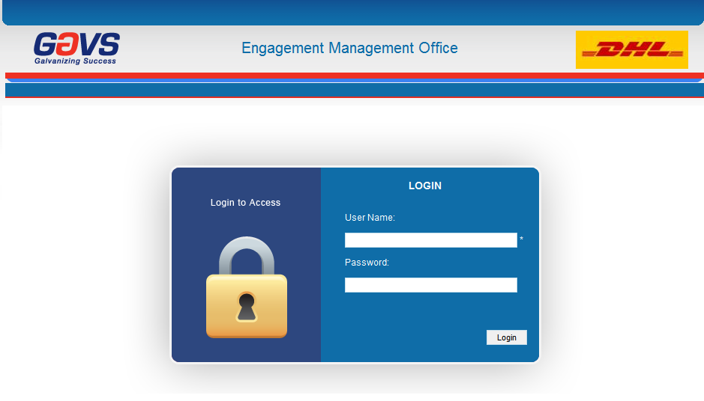
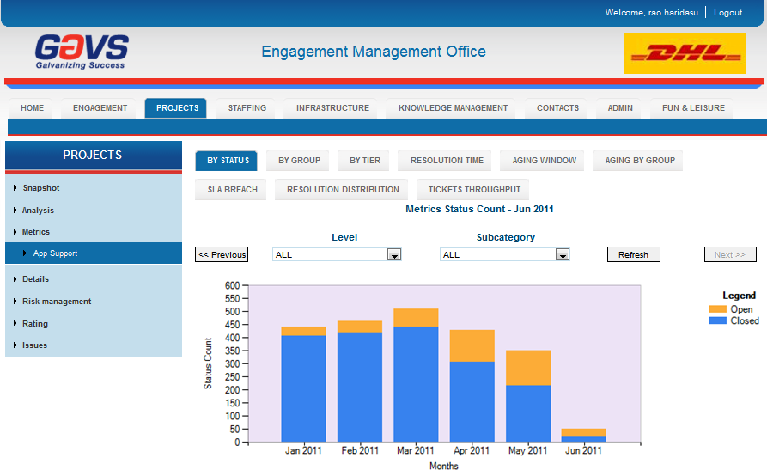
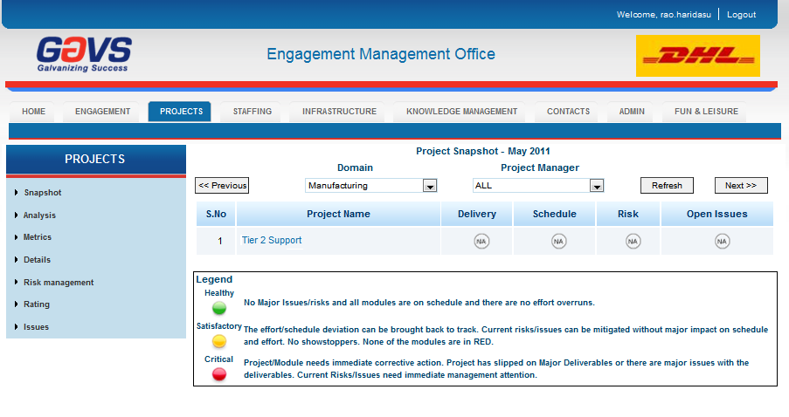
Online Reporting through EMO
One-stop shop for engagement ad project health
23

Slide 24
Commercials
Notes:
ADD QUALITY STATEMENT

Slide 25
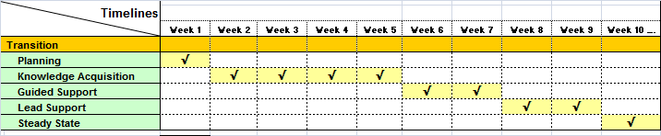
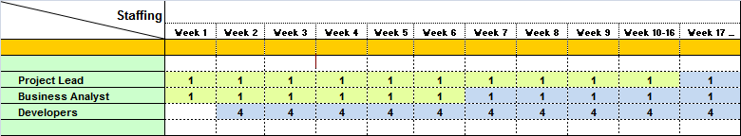

Timelines
Provided sample
9-week Knowledge Transition, followed by Steady State
The Project Lead and Business Analyst will travel to onsite for transition and move back to offshore during Steady State

Slide 26
Commercials
Sample provided
Phase- | Item | Week 1 – 6 | Week 7 – 16 | Week 17 …
Knowledge Acquisition | Resource Cost | -
 | Travel & Expense
Guided & Lead Support / Stabilization | Resource Cost
 | Travel & Expense
Steady State | Resource Cost
 | Travel & Expense
<Any note>

Slide 27
Roadmap
Notes:
ADD QUALITY STATEMENT

Slide 28
Roadmap towards a Managed Service
<Sample provided>
Resource-based
Gen 3+
Target in 6-months
Gen 3
Current state
Gen 2
Value
Performance-based
Gen 1
Gen 0
Staff Augmentation
Co-Mingled Teams
Delivery with SLAs
Managed Services
Delivery with Business SLAs
T&M
T&M
T&M
Fixed price
Output Based pricing
Fixed price
Output based pricing
Outcome based pricing
System Based pricing
Transition from a resource-based staff augmentation model to an outcome-based Managed Services model

Slide 29
Appendix
Notes:
ADD QUALITY STATEMENT

Slide 30
KT Templates
Configurable item | Purpose | Template
KT Calendar | SME calendar for KT
KT Checklist | Checklist for KT
KT Scorecard | Tracking progress of KT | mpp
KT Status Report | Weekly status report | GAVS WSR
KT MOM | Minutes of the meeting | GAVS MOM
Application document | Deliverable after KT phase covering the process and SM overview | < to be developed>
Application knowledge acquisition checklist | Checklist for knowledge acquisition process | < to be developed>

Slide 31
Appendix – KT Templates
Configurable item | Purpose | Template
KT Feedback form | Feedback form for rating GAVS team
Reverse KT | Reverse knowledge transition
Sign-off checklist | Checklist for signing-off the KT process

Slide 32
        THANK YOU

